Slide 1
Contents
Design Methodology
Design Principles
Design issues
OO Design
Representing OO Designs in the UML
Design Documentation

Slide 2
Design Methodology
We have an abstract description of a solution to our customer’s problem, a software architectural design, a plan for decomposing the design into software units and allocating the system’s functional requirements to them
No distinct boundary between the end of the architecture-design phase and the start of the module-design phase
No comparable design recipes for progressing from a software unit’s specification to its modular design
The process taken towards a final solution is not as important as the documentation produced

Slide 3
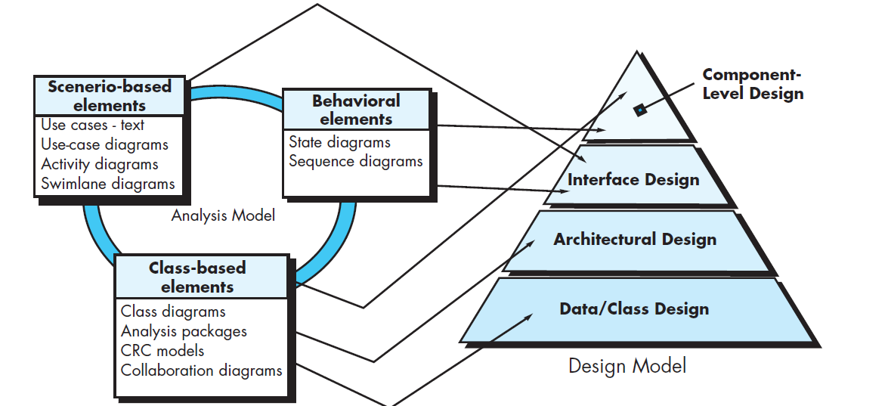

Slide 4
Design Principles
Design principles are guidelines for decomposing a system’s required functionality and behavior into modules
The principles identify the criteria
for decomposing a system
deciding what information to provide in the resulting modules
Six dominant principles:
Modularity
Interfaces
Information hiding
Incremental development
Abstraction
Generality

Slide 5
In the ideal design process, the design of a software system would progress from high-level specification to solution, using a sequence of top-down, error-free design decisions resulting in a hierarchical collection of modules
For several reasons (e.g., poorly understood or changing requirements, refactoring, human error), design work rarely proceeds directly or smoothly from requirements to modules
Refactoring :is a reorganization technique that simplifies the design (or code) of a component without changing its function or behavior
Process
decomposing the software unit into modules
defining the module interfaces
describing the interdependencies among modules
documenting the internal designs of modules

Slide 6
Design Principles : Modularity
Modularity is the principle of keeping separate the various unrelated aspects of a system, so that each aspect can be studied in isolation (also called separation of concerns)
If the principle is applied well, each resulting module will have a single purpose and will be relatively independent of the others
each module will be easy to understand and develop
easier to locate faults (because there are fewer suspect modules per fault)
Easier to change the system (because a change to one module affects relatively few other modules
To determine how well a design separates concerns, we use two concepts that measure module independence: coupling and cohesion

Slide 7
Design Principles : Coupling
Two modules are tightly coupled when they depend a great deal on each other
Loosely coupled modules have some dependence, but their interconnections are weak
Uncoupled modules have no interconnections at all; they are completely unrelated
Uncoupled -
no dependencies
Loosely coupled -
some dependencies
Tightly coupled -
many dependencies

Slide 8
Design Principles Coupling (continued)
There are many ways that modules can be dependent on each other:
The references made from one module to another
The amount of data passed from one module to another
The amount of control that one module has over the other
Coupling can be measured along a spectrum of dependence

Slide 9
Design Principles Coupling: Types of Coupling
Content coupling
Common coupling
Control coupling
Stamp coupling
Data coupling
Content coupling
Common coupling
Control coupling
Stamp coupling
Data coupling
Uncoupled
TIGHT COUPLING
LOOSE COUPLING
LOW COUPLING

Slide 10
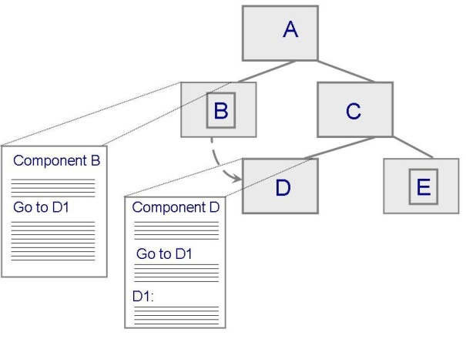
Design Principles Content Coupling
Occurs when one component modifies an internal data item in another component, or when one component branches into the middle of another component
Module B
_________________
_________________
_________________
_________________
Generate D
Call D
_________________
_________________
_________________
_________________
_________________
_________________
_________________
_________________
Module D
_________________
_________________
_________________
_________________
_________________
_________________
_________________
_________________
_________________
_________________

Slide 11
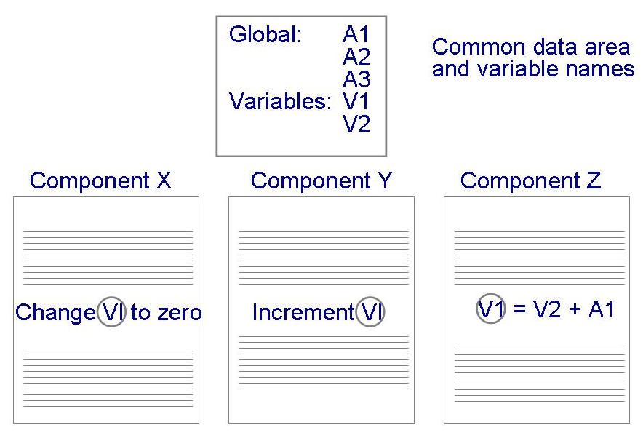
Design Principles Common Coupling
Making a change to the common data means tracing back to all components that access those data to evaluate the effect of the change

Slide 12
Design Principles Control Coupling
When one module passes parameters or a return code to control the behavior of another module
It is impossible for the controlled module to function without some direction from the controlling module

Slide 13
Design Principles Stamp and Data Coupling
Stamp coupling occurs when complex data structures are passed between modules
Stamp coupling represents a more complex interface between modules, because the modules have to agree on the data’s format and organization
If only data values, and not structured data, are passed, then the modules are connected by data coupling
Data coupling is simpler and less likely to be affected by changes in data representation

Slide 14
Design Principles Cohesion
Cohesion refers to the dependence within and among a module’s internal elements (e.g., data, functions, internal modules)
LOW COHESION
Coincidental
Logical
Temporal
Procedural
Communicational
Functional
Informational
HIGH COHESION

Slide 15
Design Principles Cohesion (continued)
Coincidental (worst degree)
Parts are unrelated to one another
Logical
Parts are related only by the logic structure of code
Temporal
Module’s data and functions related because they are used at the same time in an execution
Procedural
Similar to temporal, and functions pertain to some related action or purpose

Slide 16
Design Principles Cohesion (continued)
Communication
Operates on the same data set
Functional (ideal degree)
All elements essential to a single function are contained in one module, and all of the elements are essential to the performance of the function
Informational
Adaption of functional cohesion to data abstraction and object-based design

Slide 17
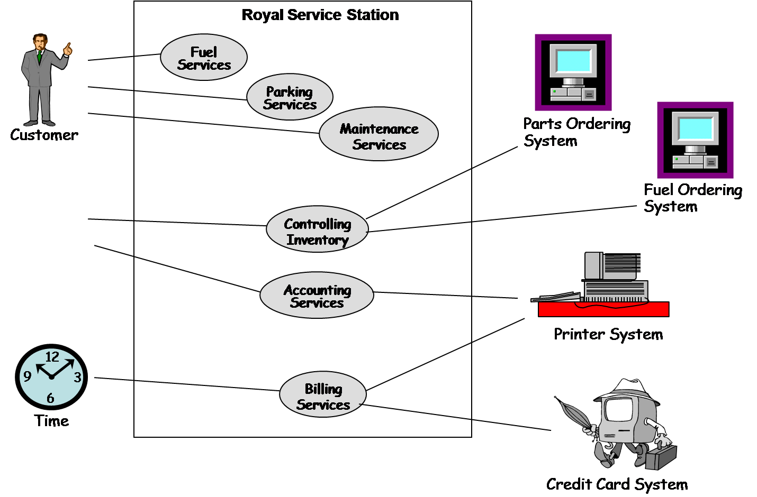
6.4 Representing OO Designs in the UML UML Class Diagram (continued)
Royal Service Station use case diagram

Slide 18
6.4 Representing OO Designs in the UML Types of Class Relationships
association
composition
aggregation
generalization
dependency
navigation

Slide 19
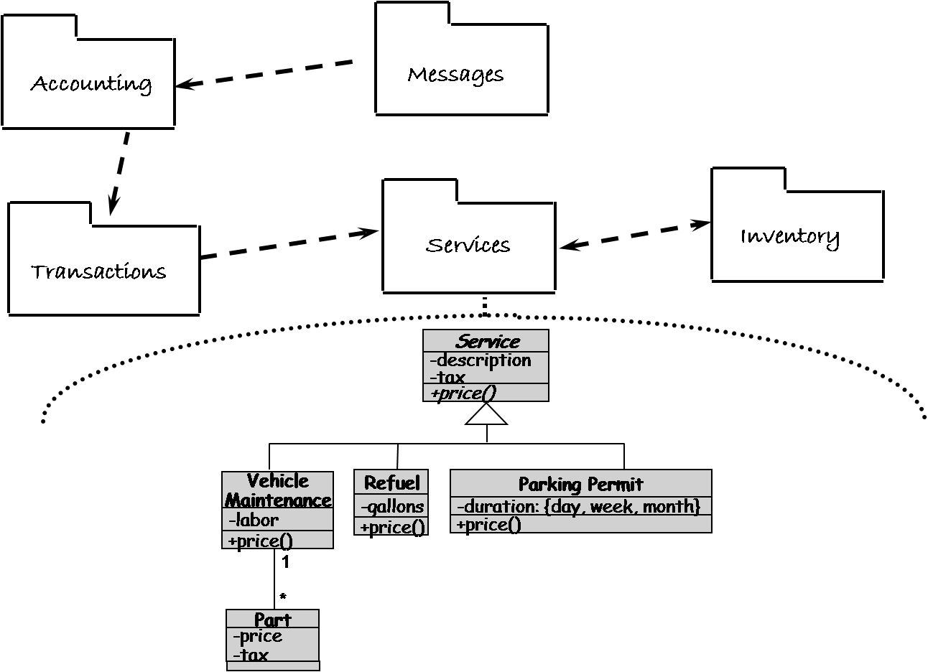
6.4 Representing OO Designs in the UML Other UML Diagrams – Package Diagram
UML package diagrams allow viewing a system as a small collection of packages each of which may be expanded to a larger set of classes

Slide 20
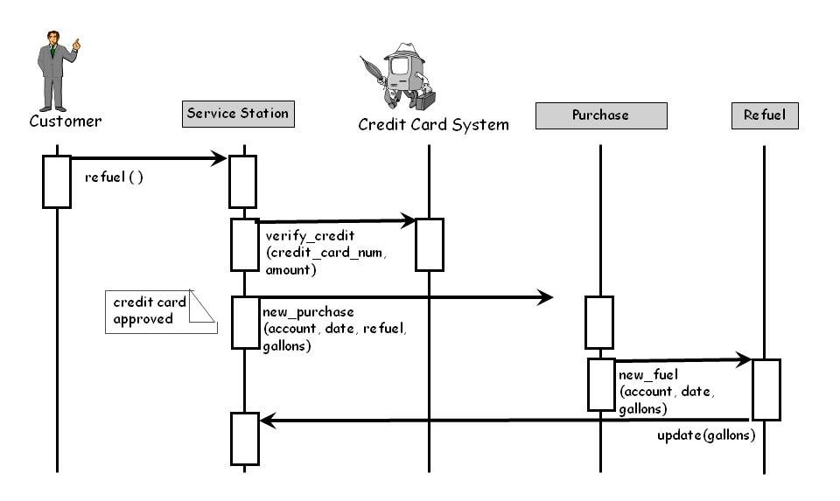
6.4 Representing OO Designs in the UML Other UML Diagrams – SequenceDiagram
Interaction diagrams describe how operations and behaviors are realized by the objects

Slide 21
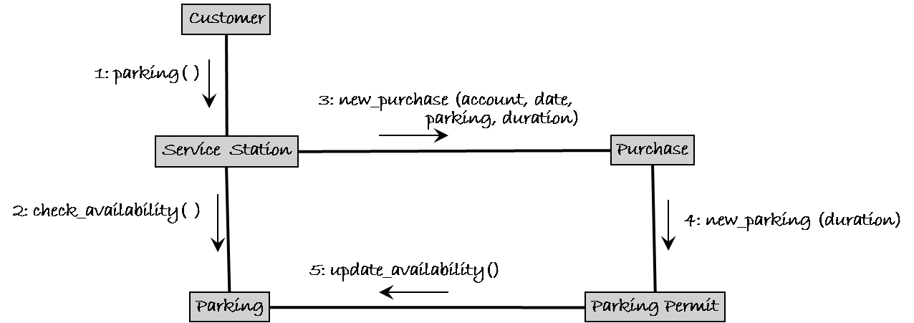
6.4 Representing OO Designs in the UML Other UML Diagrams – Communication Diagram
A communication diagram depicts a sequence of messages between objects but it is superimposed on an object and uses the links between object as implicit communication channels

Slide 22
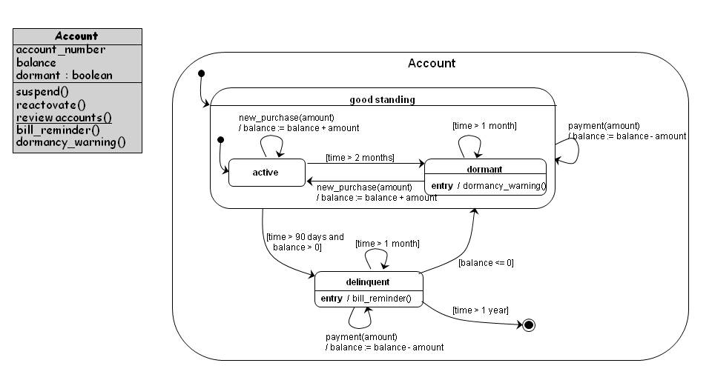
6.4 Representing OO Designs in the UML Other UML Diagrams – StateDiagram
A state diagram shows the possible states an object can take, the events that trigger the transition between one state to the next, and the actions that result from each state change

Slide 23
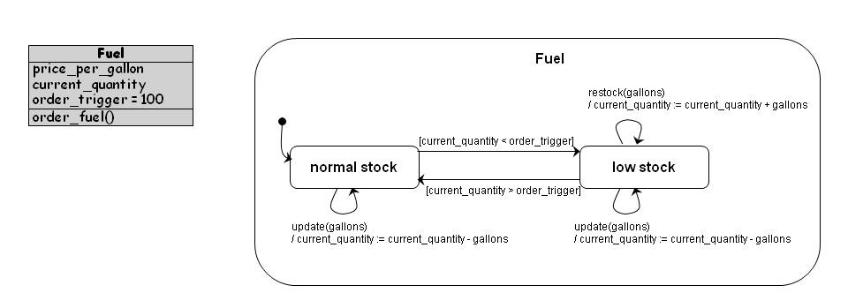
6.4 Representing OO Designs in the UML Other UML Diagrams – State Diagram (continued)

Slide 24
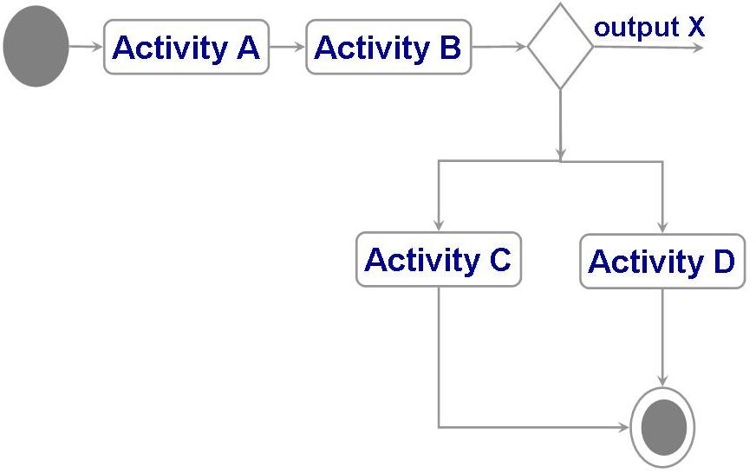
6.4 Representing OO Designs in the UML Other UML Diagrams – Activity Diagram
Activity diagrams are used to model the flow of procedures or activities in a class
A decision node is used to represent a choice of which activity to invoke

Slide 25
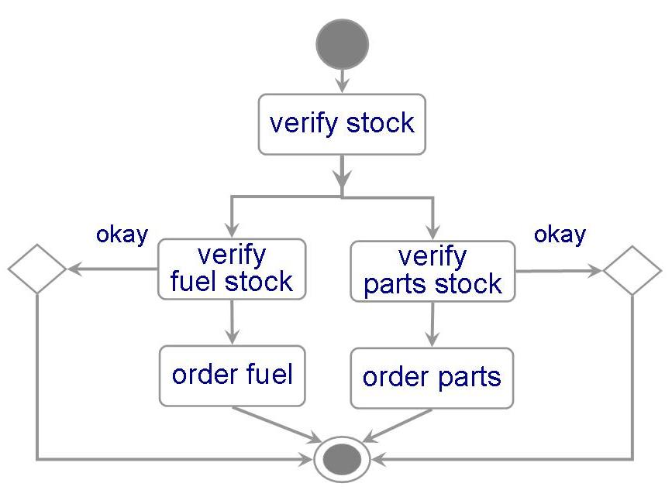
6.4 Representing OO Designs in the UML Other UML Diagrams – Activity Diagram (continued)
Activity diagrams are used to model the flow of procedures or activities in a class
An activity diagram for the inventory class
It may have two decisions
to verify that there are enough fuel
to verify that a part is in stock

Slide 26
6.5 OO Design Patterns
A design pattern codifies design decisions and best practices for solving a particular design problem according to design principles
Design patterns are not the same as software libraries; they are not packaged solutions that can be used as is. Rather, they are templates for a solution that must be modified and adapted for each particular use

Slide 27
6.5 OO Design Patterns Template Method Pattern
The Template Method pattern aims to reduce the amount of duplicate code among subclasses of the same parent class
It is particularly useful when multiple subclasses have similar but not identical implementations of the same method
This pattern addresses this problem by localizing the duplicate code structure in an abstract class from which the subclasses inherit
The abstract class defines a template method that implements the common steps of an operation, and declares abstract primitive operations that represent the variation points

Slide 28
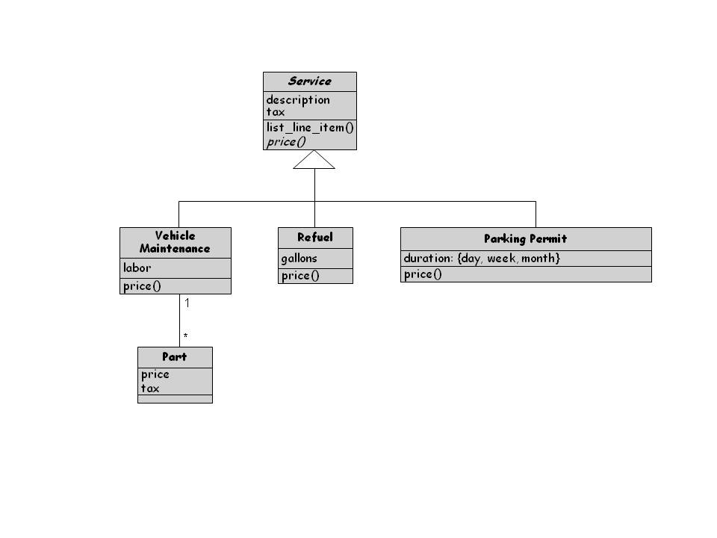
6.5 OO Design Patterns Template Method Pattern (continued)

Slide 29
6.5 OO Design Patterns Factory Method Pattern
The Factory Method pattern is used to encapsulate the code that creates objects
The factory Method pattern is similar to the Template method pattern
The similar but not identical methods are the constructor methods that instantiate objects

Slide 30
6.5 OO Design Patterns Strategy Pattern
The Strategy pattern allows algorithms to be selected at runtime
It is useful when various algorithms are available to an application but the chose of best algorithm is not known

Slide 31
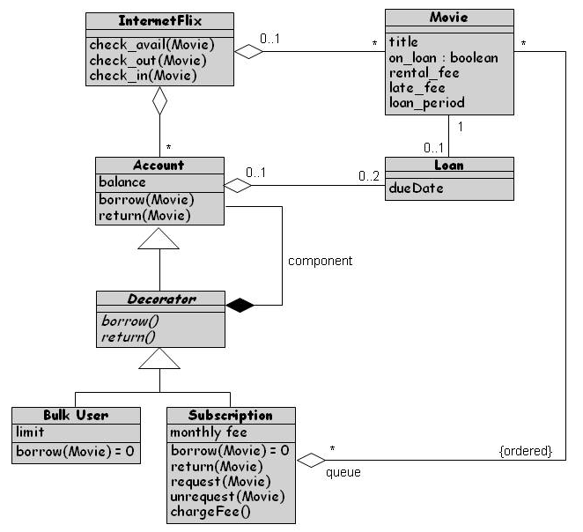
6.5 OO Design Patterns Decorator Pattern
The Decorator pattern is used to extend an object’s functionality at runtime
Decorator pattern is a flexible alternative to using inheritance at design time to create subclasses that support new features

Slide 32
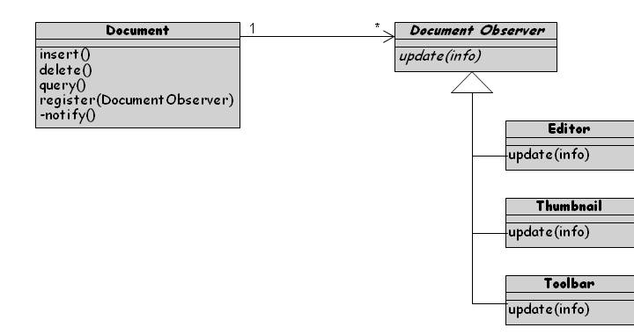
6.5 OO Design Patterns Observer Pattern
The Observer pattern is an application of the publish–subscribe architecture style
Useful when software needs to notify multiple objects of key events

Slide 33
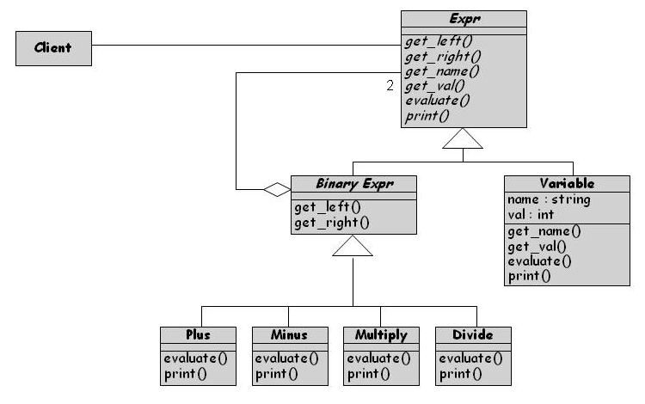
6.5 OO Design Patterns Composite Pattern
A composite object is a heterogeneous, possibly recursive, collection of objects that represents some composite entity
The composite pattern promotes the uses of a single uniform interface

Slide 34
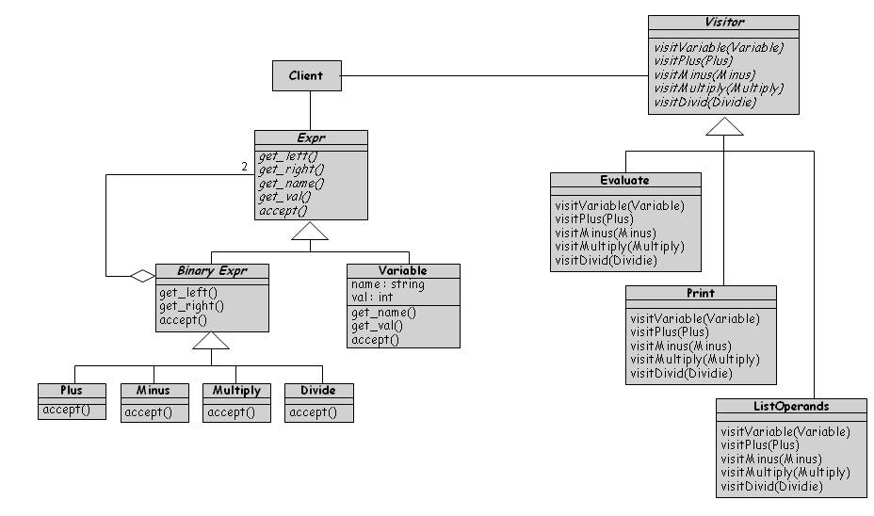
6.5 OO Design Patterns Visitor Pattern
The Visitor pattern collects and encapsulates operation fragments into their own classes
Each operation is implemented as a separate subclass of an abstract Visitor class

Slide 35
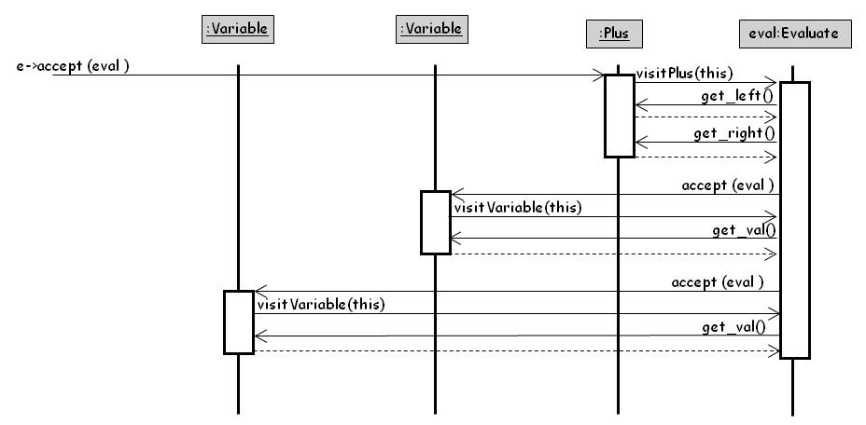
6.5 OO Design Patterns Application of Composite Pattern to Represent Math Expressions

Slide 36
6.6 Other Design Considerations Data Management
Data management takes into account the system requirements concerning performance and space
From an understanding of the data requirements and constraints, one lays out a design for the objects and their operations
Four steps:
Identify the data, data structures, and relationships among them
Design services to manage the data structures and relationships
Find tools, such as database management systems, to implement some of the data management tasks
Design classes and class hierarchies to oversee the data management functions

Slide 37
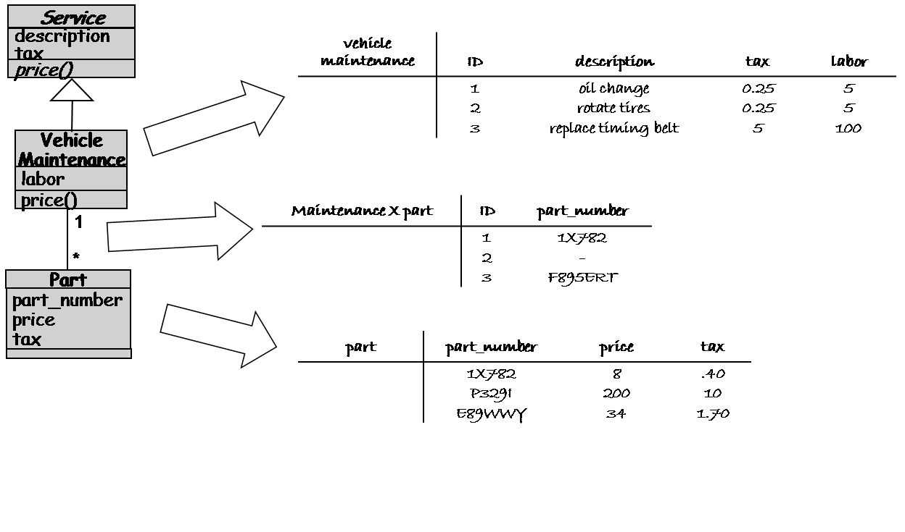
6.6 Other Design Considerations Data Management for the Royal Service Station

Slide 38
6.6 Other Design Considerations Exception Handling
Allows making programs become more robust
Helps separate error checking and recover from a program’s main functionality
Chapter 5 offers more details

Slide 39
6.6 Other Design Considerations Designing User Interfaces
Must consider several issues:
identifying the humans who will interact with the system
defining scenarios for each way that the system can perform a task
designing a hierarchy of user commands
refining the sequence of user interactions with the system
designing relevant classes in the hierarchy to implement the user-interface design
decisions
integrating the user-interface classes into the overall system class hierarchy

Slide 40
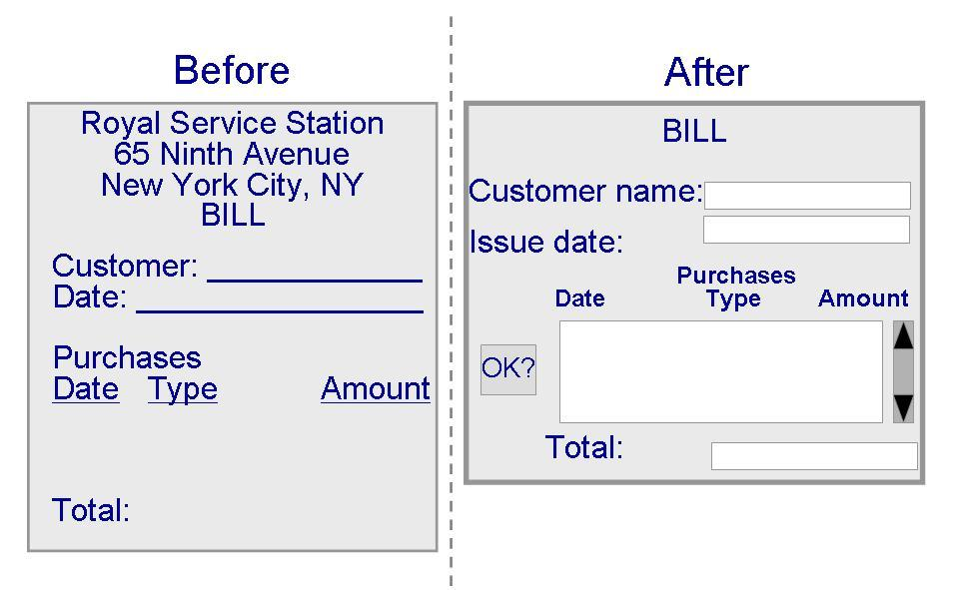
6.6 Other Design Considerations Designing User Interfaces (continued)

Slide 41
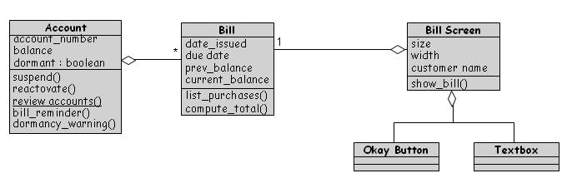
6.6 Other Design Considerations Designing User Interfaces (continued)

Slide 42
6.6 Other Design Considerations Frameworks
A framework is a large reusable design for a specific application domain
GUI editors, web applications, accounting systems
Different from software product lines
Product lines are developed by a company for its own use
Frameworks tend to be publically available resources like toolkits
High-level architectures whose low-level details need to be filled-in

Slide 43
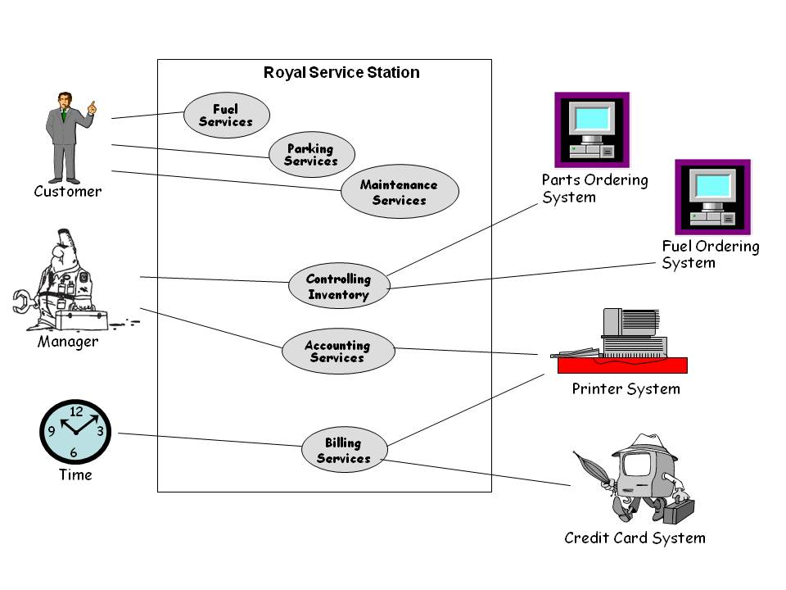
6.7 OO Measurement Use Case Diagram of the Royal Service Station

Slide 44
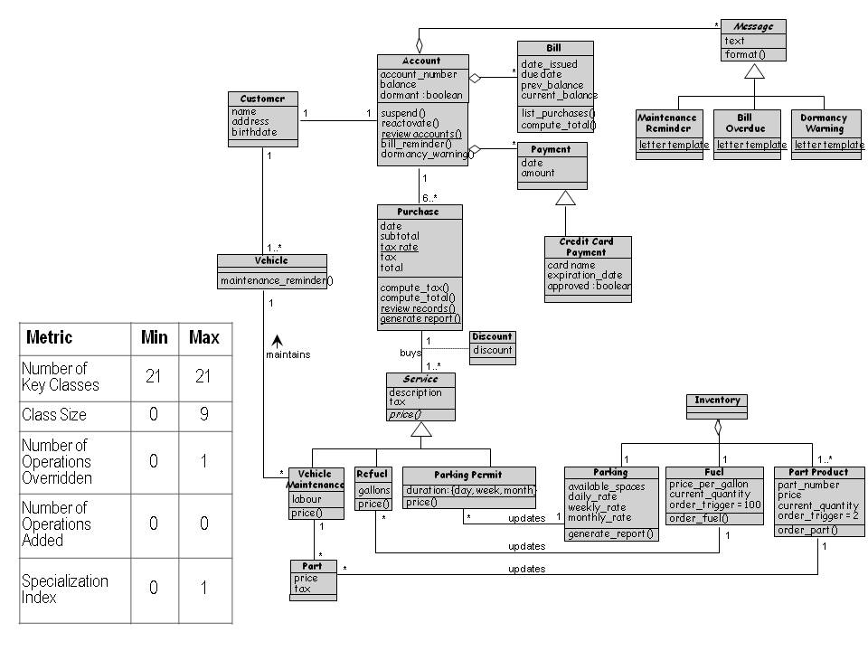
6.7 OO Measurement Class Hierarchy for the Royal Service Station

Slide 45
6.7 OO Measurement OO Design Quality Measures
Chidamber and Kemerer have also devised a suite of metrics for object-oriented development
Focused on design quality (not size)
Weighted methods per class = S^{n} _{i=1} c_{i}
Depth of inheritance
Number of children
Coupling between objects
Response for a class
Lack of cohesion of methods

Slide 46
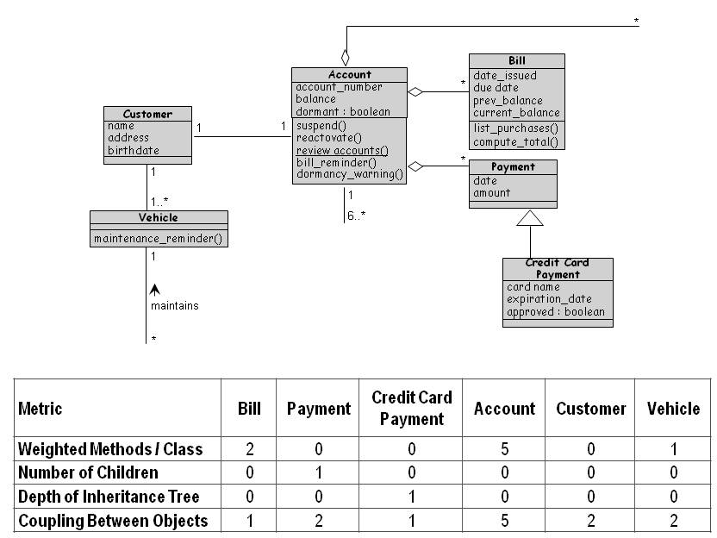
6.7 OO Measurement Chidamber-Kemerer Metrics applied to the Royal Service Station’s System Design

Slide 47
6.7 OO Measurement Other Metrics
Li and Henry (1993): metrics to predict the size of changes in classes during maintenance
Message-passing coupling: the number of methods invocations in a class’s implementation
Data abstraction coupling: the number of abstract data types used in the measured class and defined in another class of the system
Travassos (1999)
The average operation size
The average number of parameters per operation

Slide 48
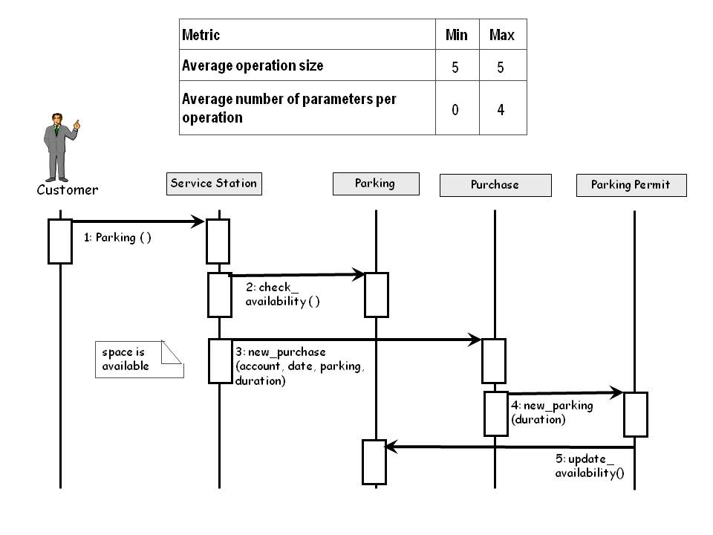
6.7 OO Measurement Measuring From a Sequence Diagram

Slide 49
6.7 OO Measurement Where to Do OO Measurement
Measurement is only valuable when it increases our understanding, prediction, or control
Metrics are available for many types of documents including
Use cases
Class diagrams
Interaction diagrams
Class descriptions
State diagrams
Package diagrams

Slide 50
6.8 Design Documentation
The details of the system architecture is documented in Software Architecture Document (SAD)
SAD serves as a bridge between the requirements and the design
Many ways to document the design
Design by contract: a particular approach that uses the documentation only to capture the design but also to encourage interaction among developers

Slide 51
6.8 Design Documentation Design by Contract
In design by contract, each module has an interface specification that precisely describes what the module is supposed to do
Meyer (1997) suggests that design by contract helps ensure that modules interoperate correctly
This specification, called a contract, governs how the module is to interact with other modules and systems
Such specification cannot guarantee a module’s correctness, but it forms a clear and consistent basis for testing and verification
The contract covers mutual obligations (the reconditions), benefits (the postconditions), and consistency constraints (called invariants)
Together, these contract properties are called assertions

Slide 52
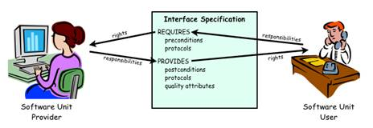
6.8 Design Documentation Design by Contract (continued)
Design contract between software provider and user

